Slide 1
Plant Biotechnology

Slide 2
Plant Biotechnology
“Plant biotechnology describes a precise process in which scientific techniques are used to develop useful and beneficial plants’’ (According to the Council for Biotechnology Information )

Slide 3
History

Slide 4
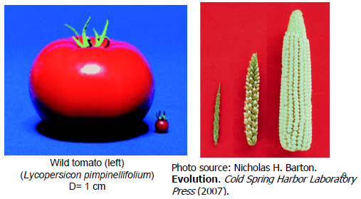
Early Plant Breeding
Humans domesticate crops.
Breed plants to further improve desirable characteristics
Traditional plant breeding selects mutants for best yield and quality (e.g., tomatoes).
Ultimate improved crop is maize: domesticated from teosinte

Slide 6
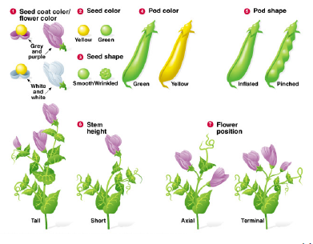
Classical Plant Breeding
The founding of the science of genetics.
Cross-breeding to strengthen traits

Slide 7
Hybrid Breeding
Two parental lines of normally outbreeding species are inbred through several self-pollinations.
When crossing such lines the first generation has hybrid vigour.
The vigour gradually disappears over the next generations so new sowing seeds have to be purchased every year .
Selection operates on desirable traits, not on survival in the wild.

Slide 8
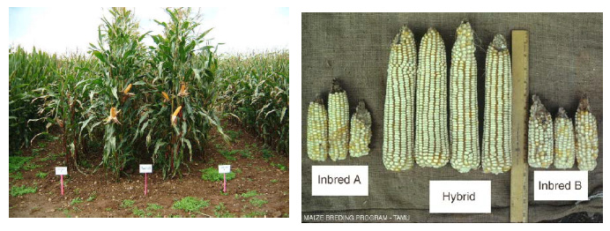
A basic type of classical plant breeding:
Hybrid breeding to strengthen traits.
Variety in genetic structure enhances viability against disease, pests, climate variability.
Selection is the process that plants with desirable characteristics are chosen from a population and then reproduced

Slide 9
Modern Plant Breeding
Mutation breeding
Green revolution
Plant tissue culture breeding

Slide 10
Mutation Breeding
Seeds are treated with radiation or mutagenic chemicals to induce larger or smaller lesions in the genes.
The mutations are at random over the genome.
Usually mutation results in a loss of function of genes

Slide 11
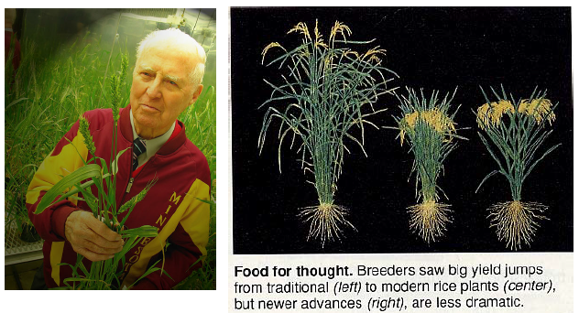
Green Revolution (1960 – 1970)
Green revolution’ leads to greatly increased crop yields based on the incorporation of dwarfing genes discovered by Norman Borlaug and the widespread use of agrochemicals

Slide 12
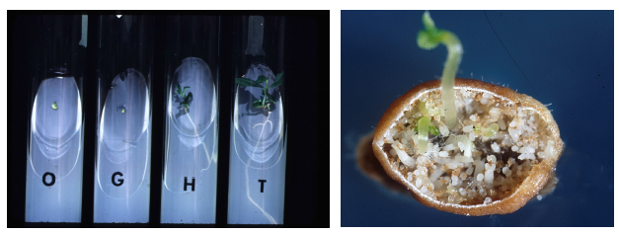
Plant tissue culture breeding
The process of selectively mating plants in aseptic culture.
Embryo rescue
Somaclonal variation selection
Somatic hybrid (i.e. fusion protoplast).
Generation of haploid (i.e. anther/microspore culture)

Slide 13
Current

Slide 14
What is the difference between a traditional breed and GMO? Attitude
Agriculture is inherently about genetically modifying crops.
While we know that there has been various forms of agriculture for more than 10,000 years or so as evidenced by seed production. Hand pollinating, cross-breeding and controlling “weeds” are all part of this long history of selecting for specific genetic structures of desirable crop traits.
Genetically modified crops, or transgenic crops, are different in that we are taking genes that would otherwise never be able to get into a given genetic structure to alter crop traits. DNA transfer could be from another crop species or even from bacteria or virus…

Slide 16
Why plant biotechnology?
Feed increasing population
Improve current process

Slide 17
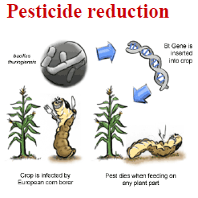
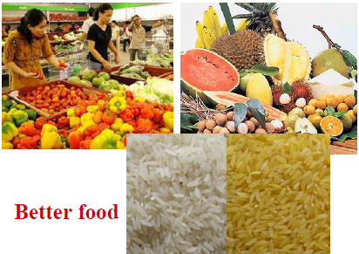
Impacts
Economic
More crops = more $
Environmental
Conservation
Pesticide reduction
Health
Better food

