Slide 1
Eggs

Slide 2
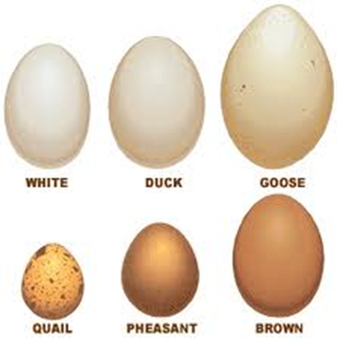
Egg Anatomy

Slide 3
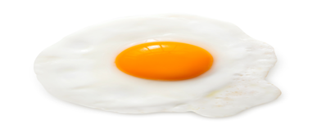
EGGS

Slide 4
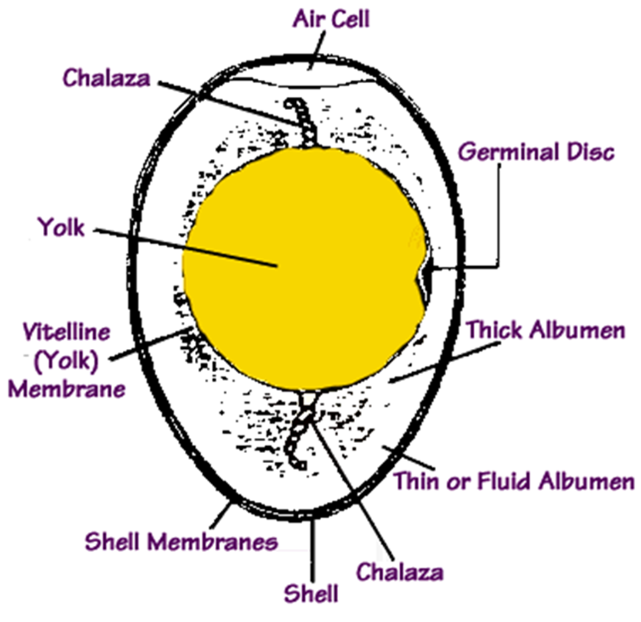
Air Cell
-Blunt end
-Contraction of egg during cooling
-Size increases as egg ages

Slide 5
Germinal Disc
-genetic information from female
-sperm fertilizes egg within the germinal disk
-white spot on the yolk

Slide 6
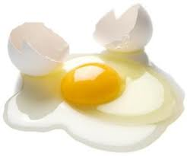
Thick and Thin Albumen
-egg white
-source of protein

Slide 7
Chalaza
-Twisted and cord like
- Anchors yolk in center of egg

Slide 8
Shell
- Calcium Carbonate
-Has pores
-Color determined by breed

Slide 9
Shell Membranes
-Attached to shell
-Encloses contents
-Protects albumen from bacteria

Slide 10
Vitelline (Yolk) Membrane
- Surrounds and seals in the yolk
-thin, elastic

Slide 11
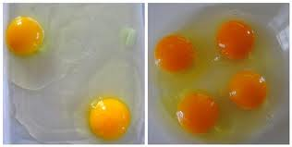
Yolk
- Color varies by feed source
- Source of vitamins, minerals & fat

Slide 12
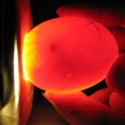
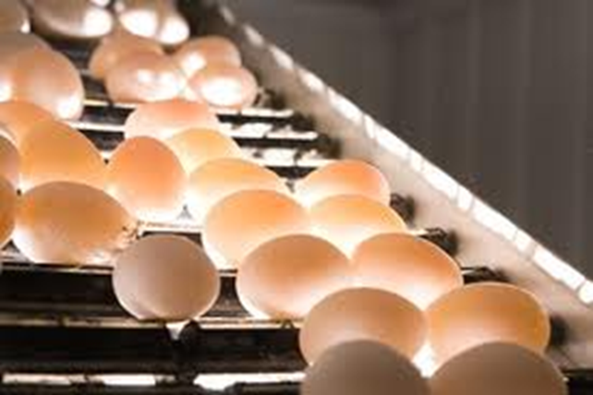
Candling Eggs
Shining a light through eggs to determine internal characteristics

Slide 13
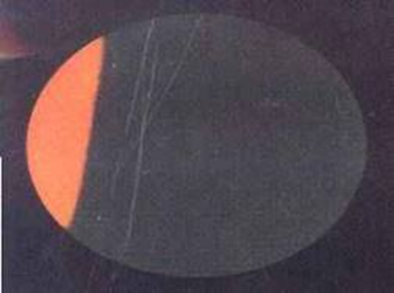
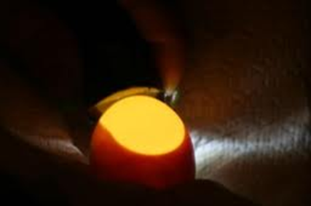
Freshly laid egg is about 107 degrees- same as hen
Egg cools to surrounding temperatures, egg contents shrink, shell remains the same, more pores at the large end of the egg– air enters and fills the space left by shrinking contents
Chicken pips through membranes to air cell– first breath of air in this space

Slide 14
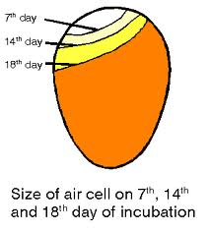
Air Cell
Increases during incubation
Not too small
Chick will be strangled on fluids
Not too big
Fluids will be dried up and chick will be weak and may stick to the shell

Slide 15
Egg Grading

Slide 16
Grades of Eggs
Appearance determines grade
External and Internal
AA
A
B
Inedible

Slide 17
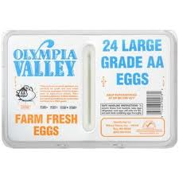
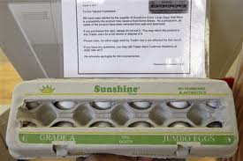
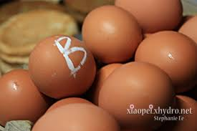
EGGS
AA
Clean, no cracks, correct shape
Albumen tight around yolk
A
Mostly good, clean
Albumen a little spread out
B
Not clean, misshapen
Albumen spread out, flat yolk

Slide 18
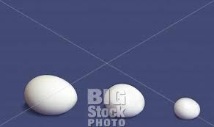
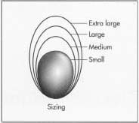
Classes
Ounces of weight/Dozen Eggs
Jumbo= 30 oz.
Extra Large= 27 oz.
Large= 24 oz.
Medium= 21 oz.
Small= 18 oz.
Peewee= 15 oz.

Slide 19
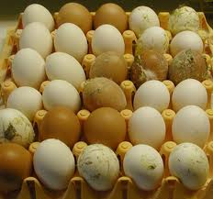
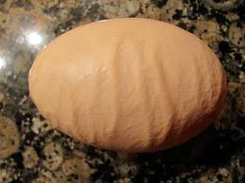
External
Clean
Shape
Cages Scratches
Cracks
Weak Spots

Slide 20
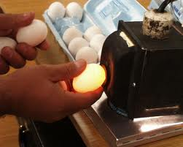
Internal
Candling= shine bright light through egg
Identify defects
Yolk Color
Blood Spots
Size of air cell
Embryonic development

Slide 21
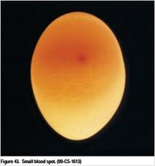
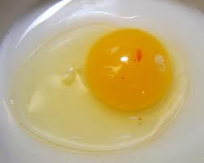
Blood Spots
*Capillary burst in reproductive system
*Doesn’t mean embryo is growing

Slide 22
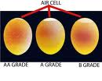
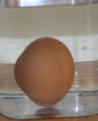
Air Cell Size
Larger = older
New Eggs= Float
Old Eggs= Sink

Slide 23
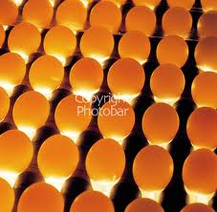
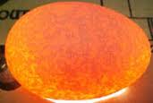
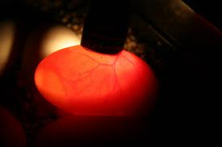

Slide 24
Egg Grading Videos
http://www.youtube.com/watch?v=NDWSnAsWor0&feature=related
http://www.youtube.com/watch?v=20inTZvPZP4
http://www.youtube.com/watch?v=BjDQ8QXB7cg&feature=related

