Slide 1
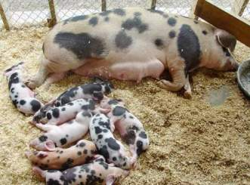
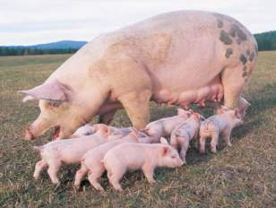
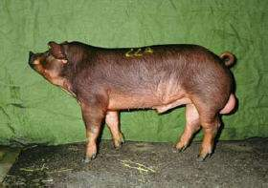
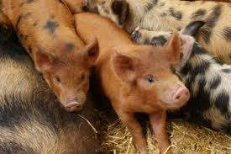
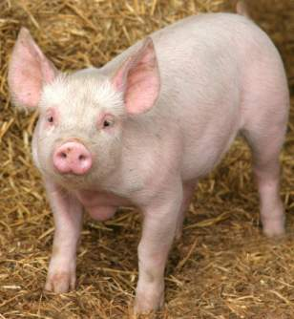
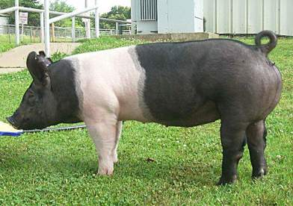
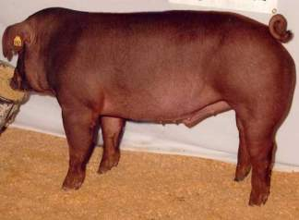
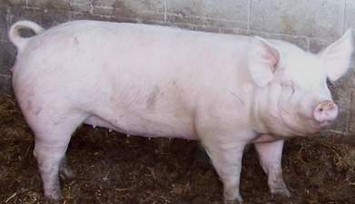
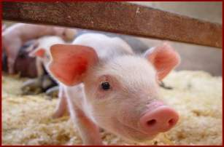

Slide 2
US Pork Production

Slide 3
Concentration
Concentrated in the Midwest
Area of major corn and soybean production
Major feed ingredients- complementary of each other
Why not expand?
Environmental Issues/Concerns
Why Midwest?
Large open land mass
Sparse population
Receptive to agriculture
Precedent: Feedlots

Slide 4
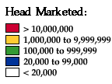
Production

Slide 5
Types of Swine Enterprises
Farrow-to-finish
Farrow-to-nursery
Farrow-to-wean
Wean-to-finish
Finishing

Slide 6
Types of Swine Enterprises
Farrow-to-finish farms manage all stages of pig growth and development, from breeding through finishing, to market weight of about 275 pounds.
Farrow-to-nursery farms specialize in the breeding of sows and raising of 40- to 50-pound feeder pigs, which are then sold to farms that specialize in feeding pigs until they reach market weight.

Slide 7
Types of Swine Enterprises
Farrow-to-wean farms oversee breeding herds and raise pigs until they are weaned at approximately 10 to 15 pounds, at which time they are sold to wean-to-finish farms.
Wean-to-finish farms purchase weaned pigs from farrow-to-wean farms and grow them until they reach market weights.
Finishing farms buy 40 to 50-pound feeder pigs from farrow-to-nursery farms and raise them until they reach
market weight.

Slide 8
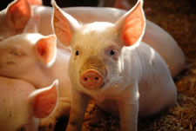
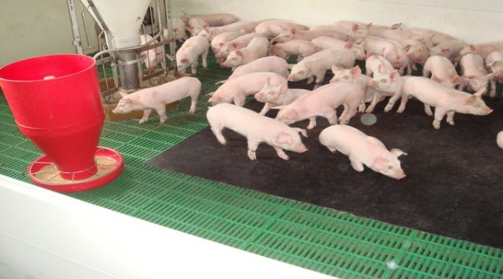
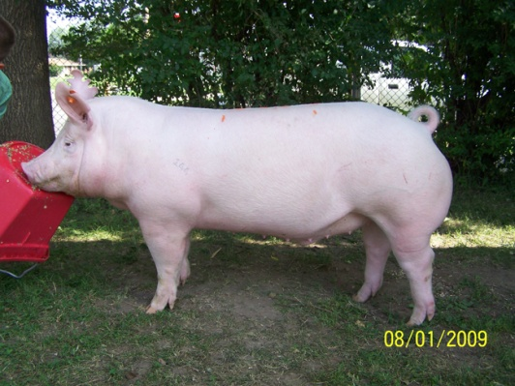
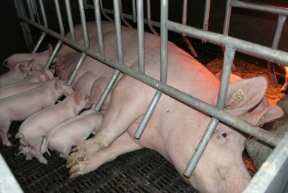
Swine Life Cycle
Farrow
0 – 3 Weeks
In Farrowing crate with mom; nurse
Shots Dock Tail Clip Needle Teeth
ID Castrate
Nursery
3 – 9 Weeks (60 lbs)
Wean from mom
Live in Pen with other litter mates
Grower/Finish
60 – 275 lbs
Time to grow and build muscle
Fed diets high in protein
Change diets to increase meat quality
Market
275 lbs (5-6 Months)
Sold for meat and by products

Slide 9
Gilts vs Barrows
Who’s leaner? Gilts or Barrows
Who eats more feed? Gilts or Barrows
Who grows faster? Gilts or Barrows
Who is more efficient? Gilts or Barrows

Slide 10
Management Practices

Slide 11
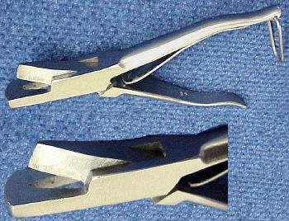
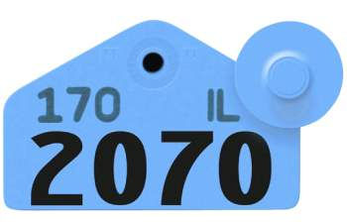
Methods of Identification
Identify Individuals
Ear notching
Ear tags
Ear tattooing

Slide 12
Ear Notches
Method of permanent identification
Pigs are ear notched using a special type of pliers that leave a V shape in their ear.

Slide 13
Ear Notching
Depicts both a litter and individual number.
Litter number is placed in the right ear
Pig number placed in the left ear

Slide 14
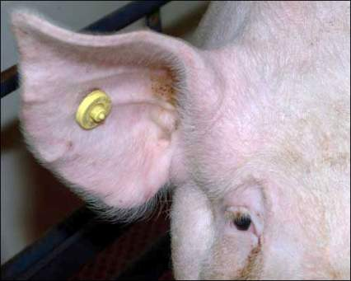
Ear tags
Easily read identification
Usually used once you have selected which pigs you will keep.
Available in different shapes

Slide 15
Ear tattooing
Another form of permanent identification
The thinner part of the lower ear is most suitable for tattooing.

Slide 16
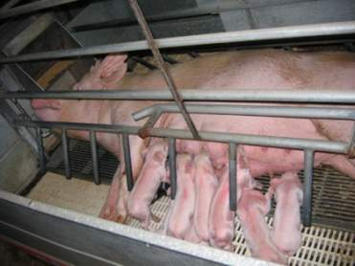
Farrowing
Sows give birth
Sows moved into farrowing crates or pens one week before farrowing date.
Guardrails about 6” from pen wall and 8” up from floor to prevent crushing
Crates to restrict the sow - typically 5’ wide and 7’ long
Once farrowing begins, piglets should be delivered in 15-20 minute intervals
Piglets average 2.5 - 4 lbs.

Slide 17
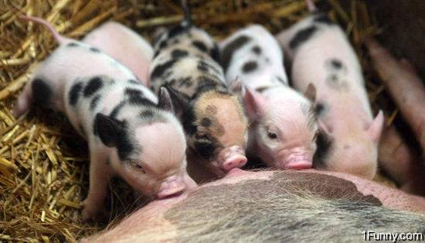
Processing piglets
Recommended 1-4 days post weaning.
The steps of processing are:
Clip needle teeth
Cut navel cord
Iron injection
Dock tails
Castrate males
Ear notch

Slide 18
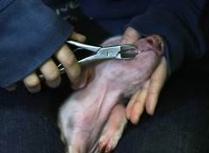
Clip needle teeth
Piglets have 8 needle teeth located on the sides of upper and low jaws
Clipped to prevent biting of littermates or the sows udder

Slide 19
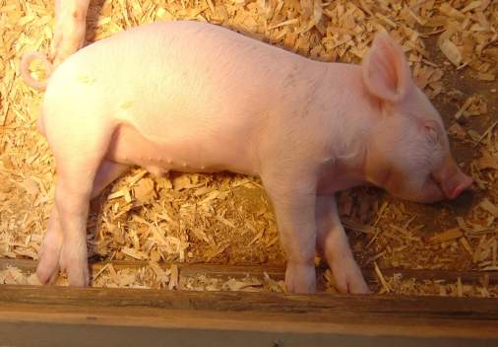
Cut navel cord
Cut to approximately 1 to 1 ½ inches in length and dipped in iodine solution.

Slide 20
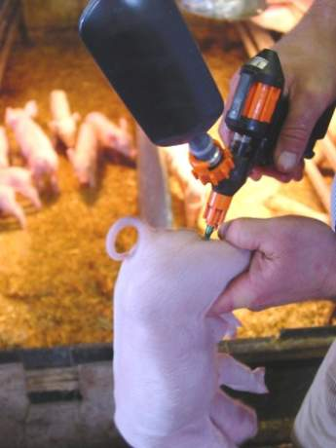
Iron injections
Given to prevent anemia which can result due to the low iron content of milk.

Slide 21
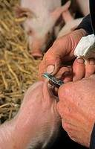
Dock tails
Cut to about 1 inch with side cutters
Prevents tail biting and cannibalism by pen mates and possible infection of tail or spinal cord

Slide 22
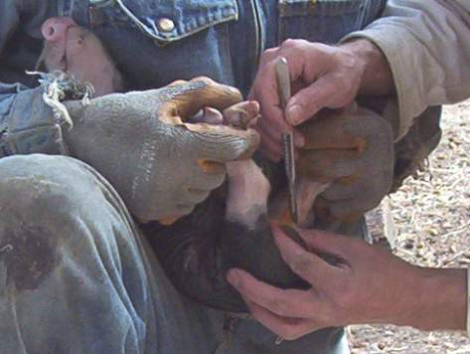
Castration
Performed on male market hogs to prevent undesirable boar odor or taint associated with cooked pork from intact males

Slide 23
Ear Notching
Identifies which litter pigs came from and so determine reproductive ability of sows.
Identifies individual pigs

Slide 24
Feeding

Slide 25
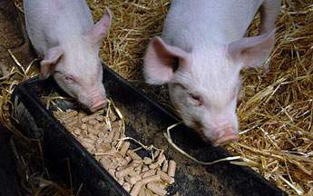
feeding program
Must balance cost and nutrient requirements
Feed according to the requirements of the animal’s stage of development
Some factors affecting nutrient requirements:
Quality of the diet: energy, by-products, molds, etc…
Breed, sex, and genetics of pigs
Stage of development of pig
Amount of time to finish pig

Slide 26
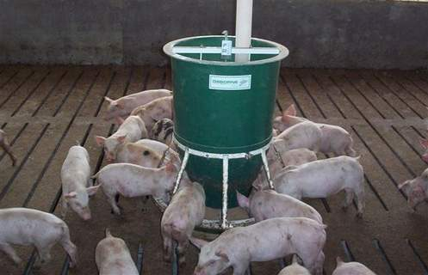
Feeding Practices
Self feeders allows young pigs to feed at will
Environmental temperature can affect appetite
Ideal temperature is 60 to 70° F.
Wetting pigs down on hot days will cool them off and improve appetite
Goal:
Average Daily Gain: 2 lbs
Feed Conversion:
3 lbs feed to 1 lb gain

Slide 27
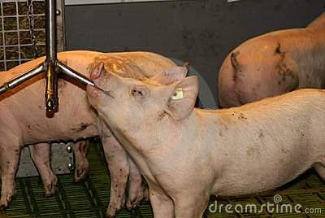
Water
Water is the most essential nutrient required by a pig
Always provide fresh, clean water
If pigs are kept outdoors, haul warm water to them during cold weather

Slide 28
Animal Behavior

Slide 29
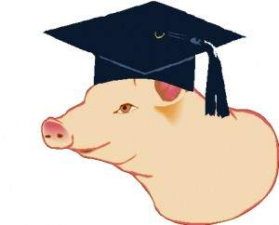
Intelligence
Pigs are intelligent and curious
They learn quickly and respond well to positive reinforcement.
It is important to make new experiences positive

Slide 30
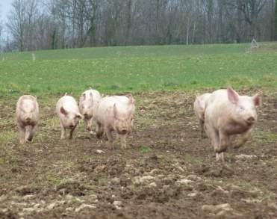
Behavior
Pigs frighten easily to unfamiliar sights, smells, and sounds
Sensitive to sharp contrast
A pig may balk if it sees shadows, puddles, bright spots, change in flooring type or texture, or drains

Slide 31
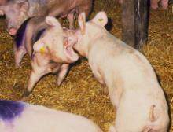
Social Hierarchy
The social organization established when unacquainted pigs are initially mixed together
They fight by mouth-to-neck attacks with strong thrusts sideways and upwards, to establish a dominance hierarchy
Hierarchy typically established within 24 hours
Aggression drops dramatically after about one hour

Slide 32
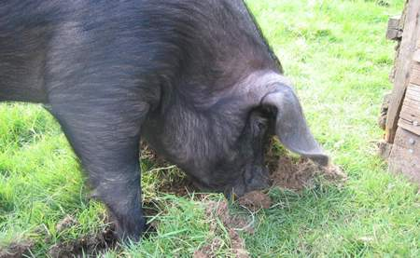
Rooting
“Rooting” is when the pig tucks its head and uses its snout to push up whatever it comes in contact with.
Natural as opposed to learned behavior

Slide 33
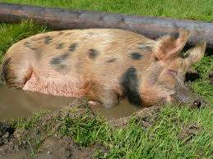
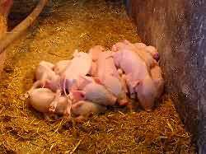
Temperature Regulation
Mature pigs are susceptible to hot conditions
Seek shade and wallow in mud or water
more active at night
Build nests to provide shelter from environmental extremes.
Young pigs are sensitive to cold
huddle with littermates
Use heat lamps

Slide 34
Breeds

Slide 35
Berkshire
Originated in England
Black color, white points and nose
Short faced with erect ears
Early-maturing
Juicy, flavorful, tender meat

Slide 36
Chester White
Developed in the United States
White with drooping ears
Large litters and excellent mothering ability

Slide 37
Duroc
Developed in the United States
Reddish brown in color
Drooping ears
Quick muscle growth
Aggressive

Slide 38
Hampshire
Developed in the United States
Black with a white belt and erect ears
Well-muscled, rapid growers
Excellent mothers
Good tempered
Good carcass quality

Slide 39
Landrace
Originated in Denmark
White in color with huge drooping ears
Longer than other breeds because of extra vertebrae
More confinement adaptable

Slide 40
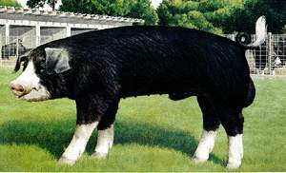
Poland China
Developed in the United States
Black with white patches, drooping ears, and large size
Maximum weight at any given age
Excellent feeders – gain readily
Quiet nature and hardy constitution

Slide 41
Spotted Swine
Developed in the United States
Black and white spotted with drooping ears
Able to transmit their fast-gaining, feed efficient, meat qualities to their offspring

Slide 42
Yorkshire
Originated in England
White with erect ears
“Mother breed”- large litters and excellent milking, and mothering ability
Muscular with high proportion of lean meat
Back to Objectives

